Slide 1
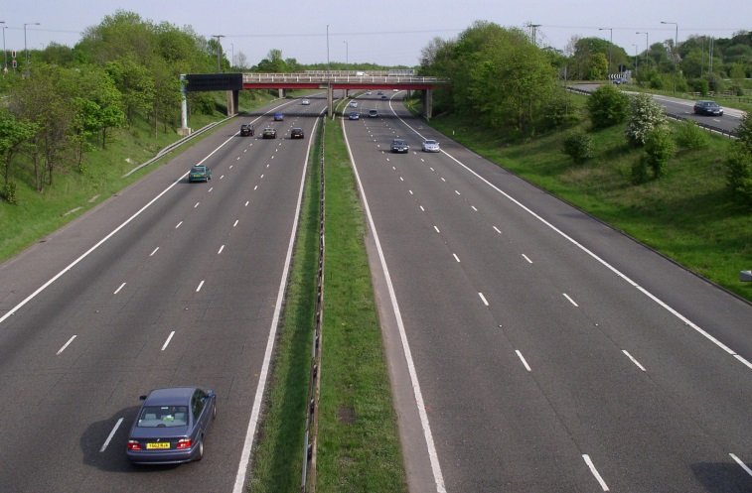
DRIVING
When do you need to think about numbers when you are driving ?
© COPYRIGHT SKILLSHEETS 2016
Notes:
Speeds, distances, times, petrol cost………..

Slide 2
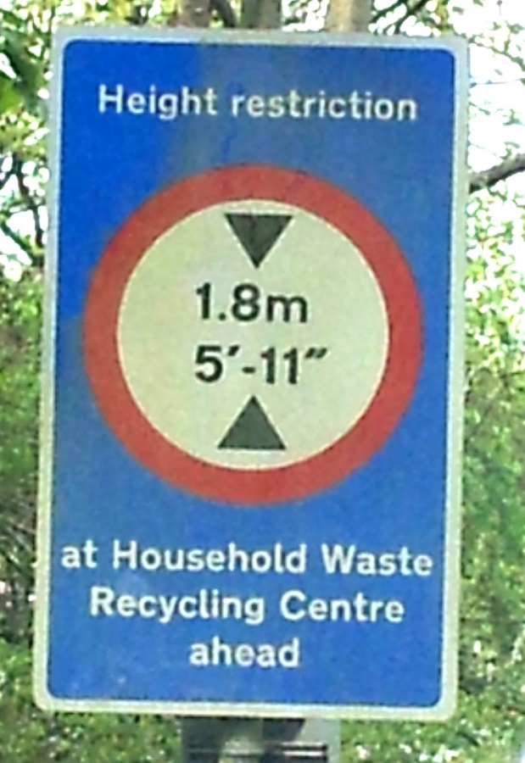
What is this sign telling you ?
What does 5’-11” mean ?
?
?
Notes:
5 feet and 11 inches

Slide 3

One foot is the same as 12 inches.
One inch is 2.54 cm.
How can you convert 5’ 11” into 1.8 metres ?
?
?
Notes:
5’ 11” is 60+11= 71 “ 71 x 2.54 =180.34 cm which is just over 1.8 metres.

Slide 4
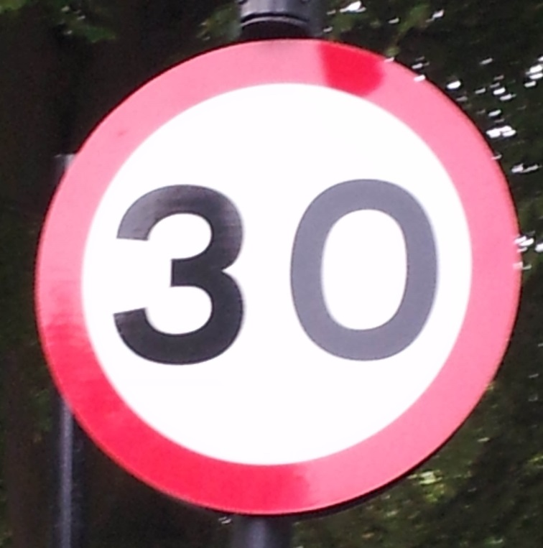
What does this sign tell drivers ?
Notes:
The speed limit is 30 miles per hour.

Slide 5

If you drive at this speed for two hours how far will you travel ?
How far would you drive in half an hour ?
How many miles would you travel in three and a half hours ?
Notes:
60 miles, 15 miles, 105 miles. Mention that it is unlikely that you would ever drive for 3½ hours at this speed but it is a useful way of estimating journey times.

Slide 6
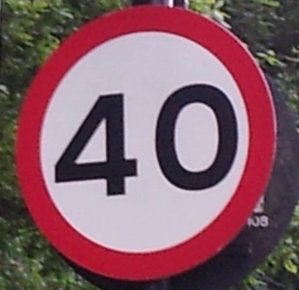
If you drive at this speed for three hours how far will you travel ?
How far would you drive in a quarter of an hour ?
How many miles would you travel in two and three quarter hours ?
Notes:
120 miles, 10 miles, 110 miles

Slide 7
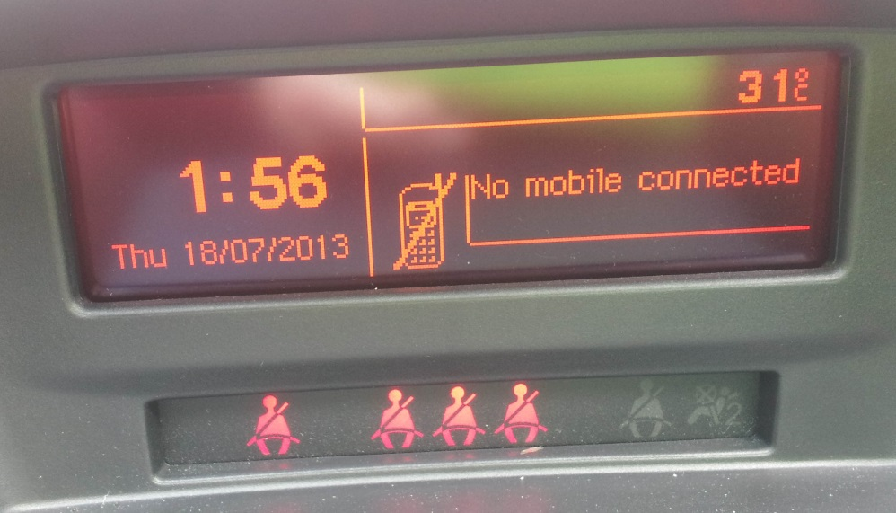
The temperature in the car
is 31 degrees Celsius.
Use this formula to convert the temperature into degrees Fahrenheit.
F = 1.8 C + 32 F is the temperature in degrees Fahrenheit.
C is the temperature in degrees Celsius.
Notes:
87.8°F which rounds to 88°F

Slide 8
I have a hospital appointment at 2.35 pm.
How many minutes do I have left for the journey ?
Notes:
4 + 35 = 39 minutes

Slide 9
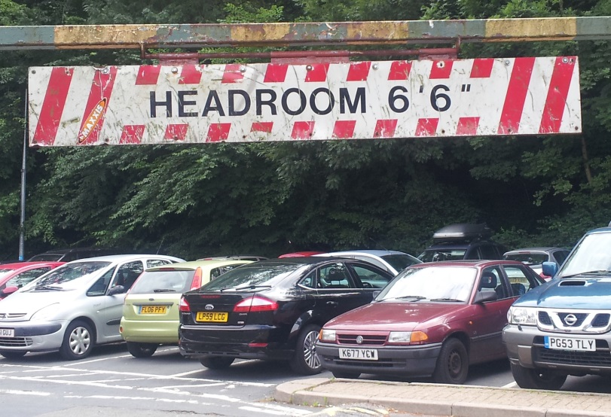
One foot is the same as 12 inches.
One inch is 2.54 cm.
Can a van that is two metres tall
drive safely under the barrier ?
Notes:
2 metres = 200 cm, 200/2.54 = 78.74 inches which is about 6 foot 6.74 inches so NO the van could not.

Slide 10
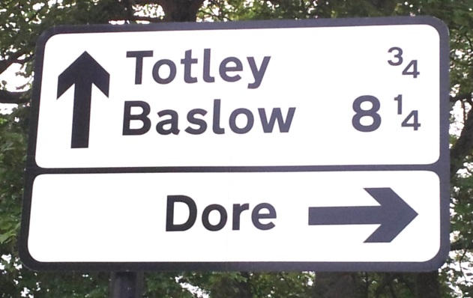
If you drive straight on past this sign you will
arrive in Totley then on to Baslow on the same road.
How many miles would you drive
between Totley and Baslow ?
Notes:
8¼ - ¾ = 7½ miles

Slide 11
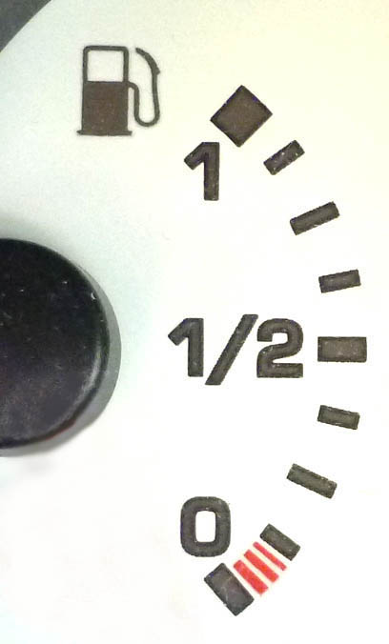
When it is full the petrol tank holds 60 litres.
How much petrol is in the tank now ?
One gallon is the same as 4.546 litres.
How many gallons are there in a full tank of petrol ?
?
?
Notes:
45 litres, 60 litres = 60/4.546 =13.1984 which is about 13.2 gallons

Slide 12
What fraction of the tank is full ?
What fraction of the tank is empty ?
?
?
Notes:
3/8 full and 5/8 empty

Slide 13
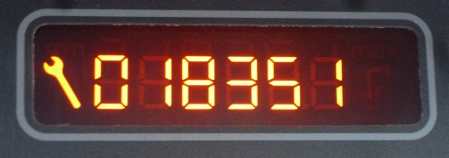
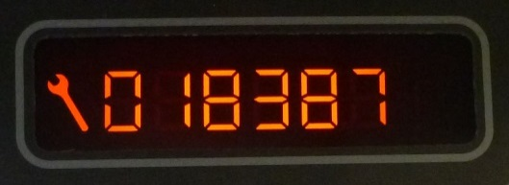
Reading when Jessica set off
How many miles did Jessica drive ?
Reading when Jessica arrived
5 miles is the same as 8 kilometres. How many kilometres did Jessica drive ?
Notes:
She drove 36 miles or 57.6 kilometres

Slide 14
Jessica’s car needs a service when it has driven 20,000 miles.
How many miles can she drive before her car needs a service ?
Notes:
1613 miles

Slide 15
When it is full the petrol tank holds 60 litres.
1 litre of petrol costs 129.9p.
How much will it cost to fill the tank ?
Notes:
3/8 of 60 = 22.5 litres, 22.5 x 129.9 = 2922.75p = £29.23

Slide 16
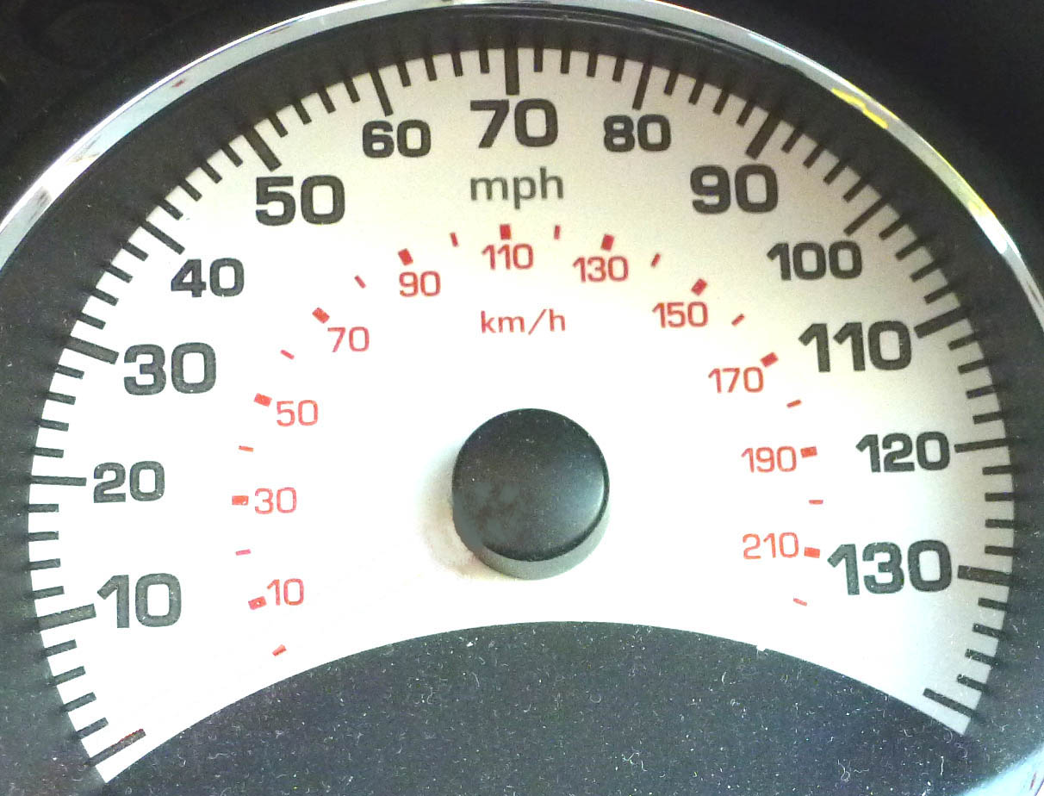
What speed is the car doing in miles per hour ?
What speed is the car doing in kilometres per hour ?
Notes:
58 miles per hour or about 92 kilometres per hour

Slide 17
5 miles
is the same as
8 kilometres.
50 miles per hour is the same as kilometres per hour.
Notes:
80 kilometres per hour

Slide 18
Which speed is faster 60 miles per hour or 90 kilometres per hour.
Notes:
60 miles per hour is faster ( same as 96 km p h )

Slide 19
5 miles
is the same as
8 kilometres.
Convert 30 miles per hour into kilometres per hour.
Check your answer by looking at the speedometer.
Notes:
48 km p h

