Slide 1
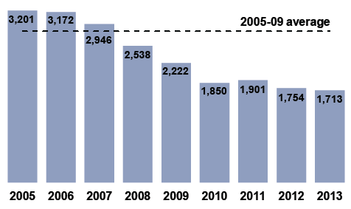
DRIVING
How can we use data to see how safe our roads are ?
Does looking at driving data help change drivers’ habits ?
© COPYRIGHT SKILLSHEETS 2016

Slide 2
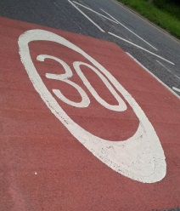
Speed in miles per hour | Percentage of cars
Below 20 | 5
20 to 29 | 49
30 to 34 | 30
35 to 39
40 to 44 | 3
45 to 49 | 1
A survey was done to measure the speed of cars on roads where the speed limit was 30 miles per hour.
Work out the number that is missing from the table.
What percentage of the cars were travelling at or above the speed limit ?
Notes:
12%, 46%

Slide 3
Speed in miles per hour | Percentage of cars
Below 20 | 5
20 to 29 | 49
30 to 34 | 30
35 to 39 | 12
40 to 44 | 3
45 to 49 | 1
52,237 cars were included in the
30 mph speed zone survey.
How many of the cars were driving at speeds less than 20 miles per hour ?
How many of the cars were driving below the speed limit ?
Notes:
2612 cars, 28,208 cars

Slide 4
This graph was drawn to show the results of surveys done between 2006 and 2013 to find out how fast cars drive on motorways.
Describe what the graph shows.
Notes:
It shows that the percentage of cars breaking the speed limit on motorways has fallen during the seven year period from 54% to 47%. Plot a three year moving average graph to show the trend better.

Slide 5
The speeds of 390,534 cars were recorded in the 2013 survey.
How many cars were travelling at speeds over 70 miles per hour in the 2103 survey ?
Notes:
183,551 cars

Slide 6
Deaths in Road Accidents by Gender
Are these statements TRUE or FALSE ?
About a quarter of people who die in
road accidents are female.
A person who dies in a road accident is three times as likely to be male than female.
75% of males will die in road accidents.
FEMALE
MALE
Notes:
True, true, false

Slide 7
Reported Road Casualties in Great Britain, 2012 Killed 1,754 Seriously Injured 23,039 Slightly Injured 170,930
Work out the total number of road casualties in 2012.
What percentage of the casualties were in each group ?
Notes:
Total 195,723 1%, 12% and 87%

Slide 8
The number of people killed on our roads has fallen from around 5,500 per year in the mid 1980s to 1,754 in 2012. However, this still means that five people die on Britain's roads every day.
Work out the percentage decrease in the number of road deaths.
How did they work out that ‘five people die’ on the roads every day ?
Notes:
68% decrease, 1754/365 = 4.805… which rounds off to about 5 people per day

Slide 9
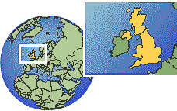
Road Deaths in the UK
What information does this bar chart show ?
Notes:
It shows the number of road deaths each year between 2005 and 2013. It also compares all years with the average for the years 2005 to 2009.

Slide 10
Road Deaths in the UK
What was the average number of deaths in the years 2005-09 ?
What was the average number of deaths in the years 2010-13 ?
Notes:
147079/5 = 2816 deaths per year, 7218/4 = 1805 deaths per year

Slide 11
Road Deaths in the UK
‘The number of road deaths nearly halved from 2005 to 2013’ TRUE or FALSE ?
Work out the percentage decrease in the number of road deaths between 2005 and 2013 ?
Notes:
Half of 3201 = 1600.5 so yes it is true. 46% decrease

Slide 12

In 2013, 1,713 people were killed in road accidents reported to the police, the lowest number on record, and half as many as in 2000.
How many people were killed in road accidents in 2000 ?
Notes:
2 x 1713 = 3426 this is probably a rough figure.

Slide 13
Estimate the percentages of casualties
in each group.
Car occupants
Pedestrians
Motorcyclists
Cyclists
Other
Other
Motorcyclists
Pedestrians
Cyclists
Car occupants
Notes:
Roughly 48%, 22%, 20%, 5%, 5%

